Slide 1
Network Infrastructure Security
Information Security

Slide 2
Network Infrastructure Security
Securing a Network
Security through Network Design
  Subnetting
  Virtual LAN (VLAN)
  Demilitarized Zone (DMZ)
  Security through Network Technologies
  Network Address Translation (NAT)
  Virtual Private Networks (VPN)

Slide 3
Network Infrastructure Security
Applying Network Security Devices
  Firewalls
  Proxy Servers
  Honeypots
  Network Intrusion Detection Systems
  Host and Network Intrusion Prevention Systems
  Network Protocol Analyzers

Slide 4
NAT vs Proxy Server
NAT (Network Address Translation)
Hides many devices behind one public IP
Works at network level
Transparent to users
Main purpose: save IP addresses
Proxy Server
Acts as a middleman for users
Works at application level
Users know they are using it
Main purpose: control, filter, cache, or hide identity

Slide 5
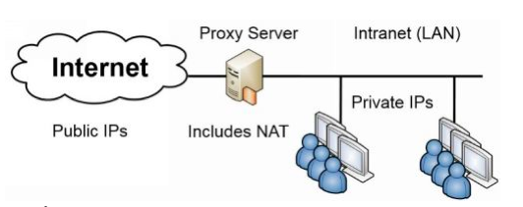
Network Infrastructure Security
Applying Network Security Devices: Proxy server
  A computer system (or an application program) that intercepts internal user requests and then processes that request on behalf of the user
  Clients cannot connect directly to the Internet; requests go to Proxy, which fetches the content (if it's permitted)
  The goal is to hide the IP address of client systems inside the secure network
  Reverse proxy: Does not serve clients but instead routes incoming requests to the correct server

Slide 6
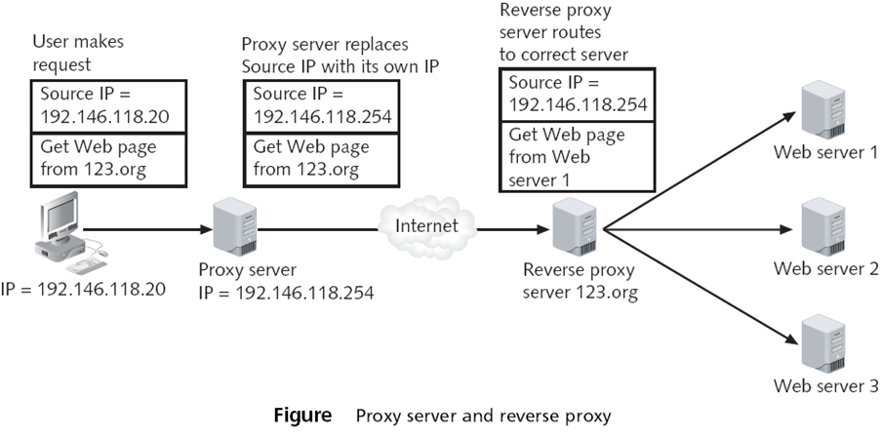
Network Infrastructure Security
Applying Network Security Devices: Proxy server

Slide 7
Network Infrastructure Security
Applying Network Security Devices: Proxy server
  Caching Proxy
  If many clients request the same page, such as yahoo.com
  The proxy only fetches one copy, and distributes it to all the clients
  Makes network seem faster

Slide 8
Network Infrastructure Security
Applying Network Security Devices: Honeypot
  Intended to trap or trick attackers
  A computer typically located in a DMZ that is loaded with software and data files that appear to be authentic
  Actually replica of real data files but fake
  Three primary purposes of a honeypot:
  Divert attention
  Early warnings of new attacks
  Examine attacker techniques

Slide 9
Network Infrastructure Security
Applying Network Security Devices: Honeypot
  Types of honeypots
  Production honeypots
    These are easy to use, capture only limited information
  Research honeypots
    Research honeypots are complex to deploy and maintain
  Information gained from studies using honeypots can be helpful in identifying attacker behavior and crafting defenses
Notes:
Crafting: Designing, shaping, producing
Research honeypot: This type of trap is used by developers, system administrators, and blue team managers working in institutions such as universities, colleges, schools and other related associations. Production honeypot: This is used by private and public institutions, companies and corporations to investigate the behavior and techniques of hackers seeking to attack networks on the Internet.

Slide 10
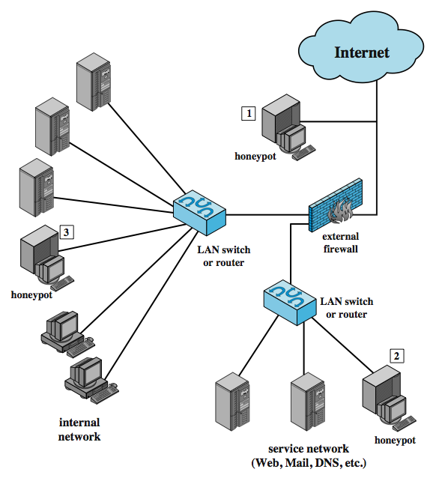
Network Infrastructure Security
Applying Network Security Devices: Honeypot Deployment

Slide 11
Network Infrastructure Security
Applying Network Security Devices: Network intrusion detection system (NIDS)
  Network intrusion detection system (NIDS)
  Watches for attempts to penetrate a network
  NIDS work on the principle of comparing new behavior against normal or acceptable behavior
  A NIDS looks for suspicious patterns

Slide 12
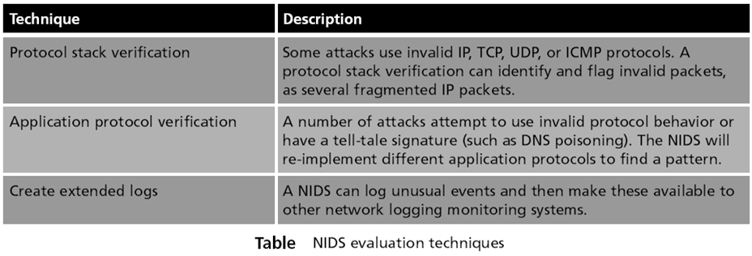
Network Infrastructure Security
Applying Network Security Devices: Network intrusion detection system (NIDS)

Slide 13
Network Infrastructure Security
Applying Network Security Devices: Network intrusion detection system (NIDS)
  Functions a NIDS can perform:
  Configure the firewall to filter out the IP address of the intruder
  Play an audio file that says “Attack is taking place”
  Save the packets in a file for further analysis
  Send an entry to a system log file
  Send e-mail or a cell phone message to the network administrator

Slide 14
Network Infrastructure Security
Applying Network Security Devices: Host Intrusion Prevention Systems (Host-IPS)
  Intrusion prevention system (IPS)
  Finds malicious traffic and deals with it immediately
    A typical IPS response may be to block all incoming traffic on a specific port
  Host intrusion prevention systems (Host-IPS)
  Installed on each system that needs to be protected
Notes:
https://www.fortinet.com/resources/cyberglossary/snort

Slide 15
Network Infrastructure Security
Applying Network Security Devices: Host Intrusion Prevention Systems (Host-IPS)
  Most Host-IPS monitor the following desktop functions:
  System calls
  File system access
  System Registry settings
  Host input/output
  Host-IPS are designed to integrate with existing antivirus, anti-spyware, and firewalls
Notes:
A system call is a way for programs to interact with the operating system. A computer program makes a system call when it makes a request to the operating system's kernel.

Slide 16
Network Infrastructure Security
Applying Network Security Devices: Network Intrusion Prevention Systems (NIPS)
  Work to protect the entire network and all devices that are connected to it
  By monitoring network traffic NIPS can immediately react to block a malicious attack
  NIPS are special-purpose hardware platforms that analyze, detect, and react to security-related events

Slide 17
Network Infrastructure Security
Applying Network Security Devices: Protocol Analyzers
  Three ways for detecting a potential intrusion
  Detecting statistical anomalies
  Examine network traffic and look for well-known patterns of attack
  Use protocol analyzer technology
  Protocol analyzers
  Can fully decode application-layer network protocols
  Different parts of the protocol can be analyzed for any suspicious behavior

Slide 18
Network Infrastructure Security
Applying Network Security Devices: Internet content filters
  Monitor Internet traffic and block access to preselected Web sites and files
  A requested Web page is only displayed if it follows the specified filters
  Unapproved Web sites can be restricted based on the Uniform Resource Locator (URL) or by matching keywords

Slide 19
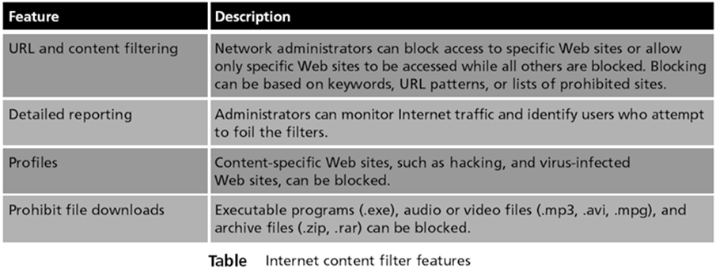
Network Infrastructure Security
Applying Network Security Devices: Internet content filters

Slide 20
Network Infrastructure Security
Applying Network Security Devices: Integrated Network Security Hardware
  Types of hardware security appliances:
  Dedicated security appliances provide a single security service
  Multipurpose security appliances that provide multiple security functions
  Integrated network security hardware
  Combines or integrates multipurpose security appliances with a traditional network device such as a switch or router
  Particularly attractive for networks that use IDS

Slide 21
Network Infrastructure Security
Applying Network Security Devices: Unified Threat Management
  Web Security Gateway or UTM Security Appliances
  Combines many security functions, such as
  URL filtering
  Firewall
  Antivirus
  Spam-blocking
  Content filtering
  Data Loss Prevention (DLP)
Notes:
Data loss prevention (DLP) makes sure that users do not send sensitive or critical information outside the corporate network
Data loss prevention (DLP) is a set of practices (and products) that ensure that an organization's sensitive or critical data remains available to authorized users and isn't shared with or available to unauthorized users.

Slide 22
Network Infrastructure Security
Hardening Systems
  A host is any device with an IP address; such as servers, workstations, printers, etc.
  Hardening is the practice of making the system more secure than a default installation
  Disabling unnecessary services
  Disabling unneeded applications
  Protecting management interfaces and applications

Slide 23
Network Infrastructure Security
Hardening Systems: Disabling Unnecessary Services
  Improves overall security position
  Less vulnerable to attacks
  Reduces the attack surface
  Prevents both known and 0day attacks against the disabled services
  Reduces risks from open ports
  Ports won’t be open when scanned
Notes:
A zero day exploit is a cyber attack that occurs on the same day a weakness is discovered in software. At that point, it's exploited before a fix becomes available from its creator.

Slide 24
Network Infrastructure Security
Hardening Systems: Other Hardening Steps
  Uninstall Unneeded Applications
  For best protection
  Disable unnecessary accounts
  Watch for default and backdoor accounts
  Protect management interfaces and applications
  Change default passwords
  Disallow administration from WAN, or limit it to specific source IP addresses

Slide 25
Network Infrastructure Security
Hardening Systems: Using Baselines
  Security baseline
  Configuration baseline
  Host software baseline
  Application configuration baseline
  Performance baseline
Notes:
Baselines: Guidelines. Measures, standards

Slide 26
Network Infrastructure Security
Hardening Systems: Security Baseline
  Starting point for OS or application
  Deployed by
  Group policy
    Group Policy Objects (GPOs)
    On Windows domains
  Security templates
  Imaging

Slide 27
Network Infrastructure Security
Hardening Systems: Security Baseline
  Security Templates
  Preconfigured settings for various common computer types
    Domain Controller
    Email server
    Web server
  Security Templates contain
    Account polices (like disabling Guest)
    Password and lockout settings
    Audit policies
    User rights
    System services
    Software restrictions

Slide 28
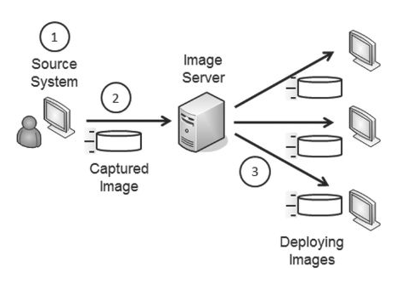
Network Infrastructure Security
Hardening Systems: Security Baseline
  Capturing and Deploying Images
  Prepare a reference computer with everything installed and configured properly
  Capture an image of the reference computer
  Deploy the image to many computers

Slide 29
Network Infrastructure Security
Hardening Systems: Security Baseline
  Image Deployment Tools
  Norton Ghost
  Acronis TrueImage
  Microsoft Windows Image Backup
  Windows Automated Installation Kit
  Windows Deployment Services
  Many others

Slide 30
Network Infrastructure Security
Hardening Systems: Security Baseline
  Imaging Benefits
  Secure starting point
  Reduced costs

Slide 31
Network Infrastructure Security
Hardening Systems: Configuration Baseline
  A record of all the settings on a system, including non-security settings and security settings
  The security baseline contains only the security settings
  Every time a system is changed, the configuration baseline must be updated
  Change management

Slide 32
Network Infrastructure Security
Hardening Systems: Host Software Baseline
  Lists all software installed on a system
  Lists all approved software
  Also called Application baseline
  Can be compared with a scan that finds all installed software

Slide 33
Network Infrastructure Security
Hardening Systems: Application Configuration Baselines
  Proper settings for applications
  Makes it easier to audit servers

Slide 34
Network Infrastructure Security
Hardening Systems: Performance Baselines
  Documents the overall performance of a system at a point in time
  Useful for reference later when performance changes

